Slide 1
Increase Enrollment in My HealtheVet (IEMHV) Accessing the (FTL) Future Technology lab IEMHV VistA Environment
May 5, 2015
Notes:
Presented by:
Don Michalak, PMP, CSM
New Models of Health Care, OED
Albany, OIFO
518-449-0242 (office)
Feel free to use all or some of this presentation but give credit to the appropriate source and authors to avoid any copyright issues.

Slide 2
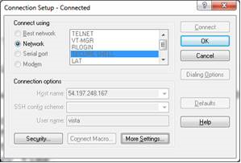
Accessing the Future Technology Labs (FTL) IEMHV VistA Environment
Step 1. Open Attachmate Reflections
Start /All Programs/Attachmate Reflections/Reflection for UNIX and OpenVMS
Step 2. In Attachmate Reflections click on “Connection” then “Connection Setup…”
Step 3. In Connection Setup fill in the below Information
In Attachmate Reflections – Connection Setup
Secure Shell
Host name: 54.197.248.167
User Name: vista
Step 4. Login to the FTL’s IEMHV VistA
Access Code: cprs1234
Verify Code: cprs4321$
Step 5. Access the preregistration Menu
^preregister

